Slide 1
Predicting housing prices in Melbourne, Australia
The goal is to predict housing prices in Melbourne, Australia. In doing so, also want to determine what gives a home its value.

Slide 2
Variable description
Suburb: Suburb Address: Address Rooms: Number of rooms Price: Price in Australian dollars Method: S - property sold; SP - property sold prior; PI - property passed in; PN - sold prior not disclosed; SN - sold not disclosed; NB - no bid; VB - vendor bid; W - withdrawn prior to auction; SA - sold after auction; SS - sold after auction price not disclosed. N/A - price or highest bid not available. Type: h - house, cottage, villa, semi, terrace; u - unit, duplex; t - townhouse. SellerG: Real Estate Agent Date: Date sold Distance: Distance from CBD in Kilometers Regionname: General Region (West, North West, North, North east ...etc) Propertycount: Number of properties that exist in the suburb. Bedroom2: Scraped # of Bedrooms (from different source) Bathroom: Number of Bathrooms Car: Number of car spots Landsize: Land Size in Meters BuildingArea: Building Size in Meters YearBuilt: Year the house was built CouncilArea: Governing council for the area Lattitude: Self explanatory Longtitude: Self explanatory

Slide 3
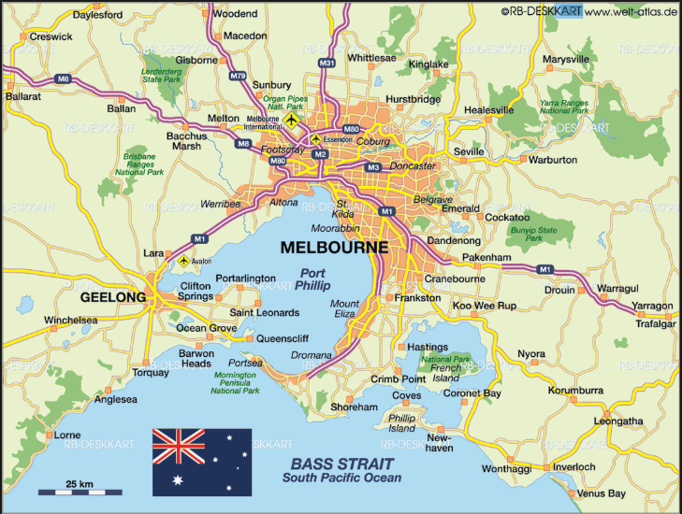
Exploring the data

Slide 4
Exploring the data
There are 34,857 observations and 21 variables in the dataset.
The variable of interest is PRICE, which had 7,610 missing values.
Postcode, Distance, CouncilArea, Regionname, and Propertycount had missing values that were filled by finding the missing information from the data. Specifically, those missing values were filled from the Suburb that contained matching values.
The remaining missing values were imputed using the Simple Imputer method from ScikitLearn. The values were imputed with the median value for each variable.
Tracker columns were added to help the models know where values were imputed.

Slide 5
Exploring the data
After imputing the data, two datasets were created:
A dataset where the median value for each suburb was imputed for the PRICE variable (imputed_df)
A dataset where the missing price values were dropped (drop_df)
Both datasets were used to make models and determinations about the data

Slide 6
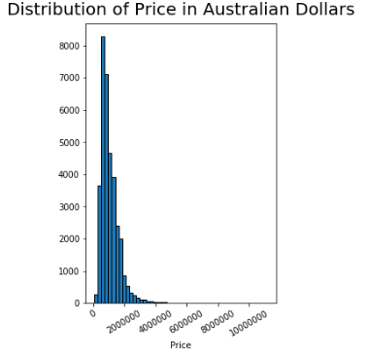
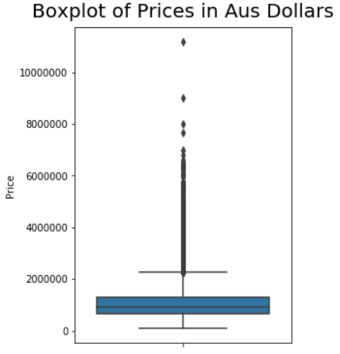
Exploring the data
The distribution for the PRICE variable is normal with a right skewness.
There are a few outliers as seen in the boxplot.
Note: this is the distribution for the PRICE from the raw data.
PRICE
mean $1,050,173.34
std $641,467.13
min $85,000.00
25% $635,000.00
50% $870,000.00
75% $1,295,000.00
max $11,200,000.00

Slide 7
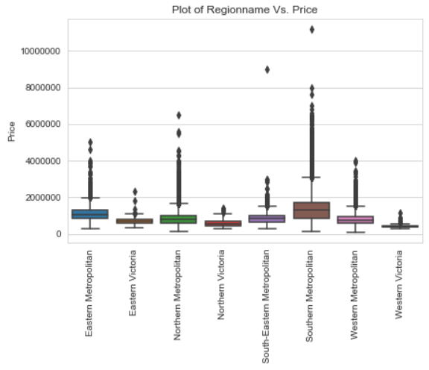
The Southern Metropolitan area has the highest median price and also contains the max price in the dataset.

Slide 8
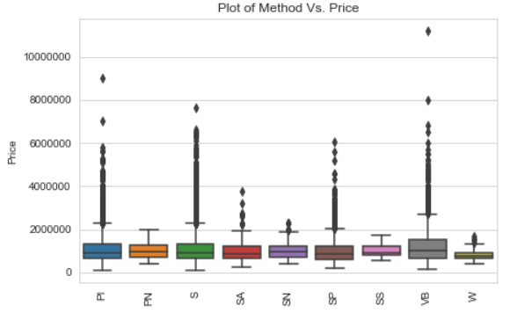
The method of sale does not seem to effect the median price for housing.

Slide 9
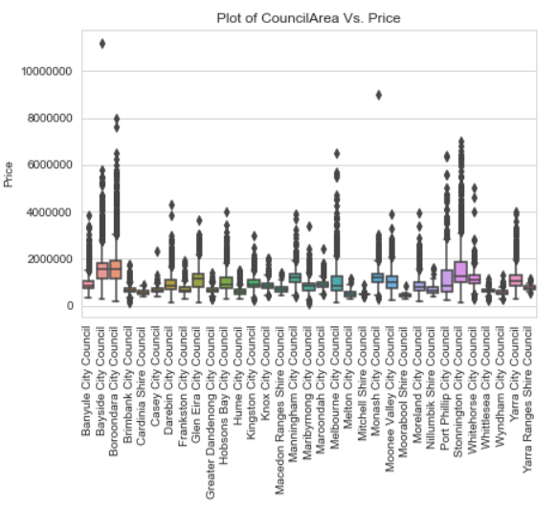
The Bayside and Boroodara council areas are the two that have the highest median price for council areas.

Slide 10
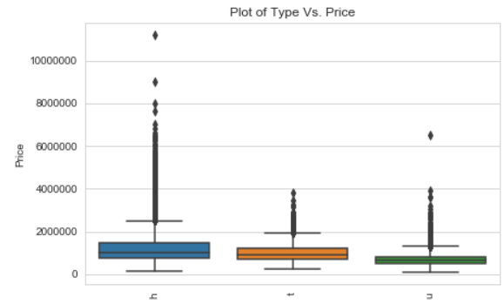
The median price is the highest for houses, then townhouses, lastly, is apartments/duplexes

Slide 11
Exploring the data
Percentage of homes by region above median value of $870,000:
Region Name
Southern Metropolitan 71.0%
Eastern Metropolitan 66.0%
Northern Metropolitan 36.0%
South-Eastern Metropolitan 35.0%
Western Metropolitan 32.0%
Eastern Victoria 12.0%
Northern Victoria 9.0%
Western Victoria 1.0%
The Southern and Eastern metropolitan areas contain a majority of homes that are above the median value. It is interesting to see the percentages drop off significantly after the top two regions. It appears that homes will likely have more value if they are in those regions.

Slide 12
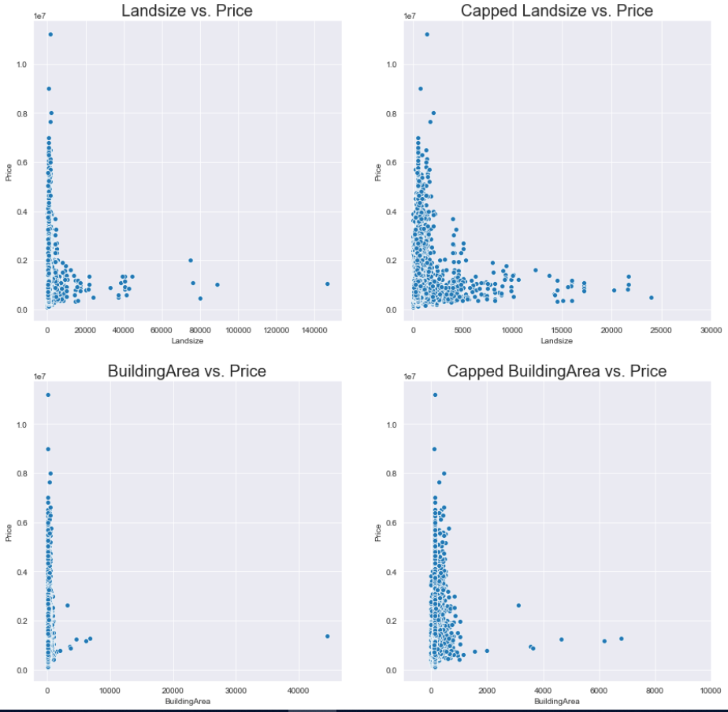
Exploring the data
The plots on the right have the axes truncated to highlight more of the data.
Units are square meters.
It seems that land size and building size do not have a positive relationship with price.
This follows the idea that homes in the metro area (specifically Southern and Eastern) may be more valuable because homes in cities are likely going to have less land in comparison to homes in a more rural area.

Slide 13
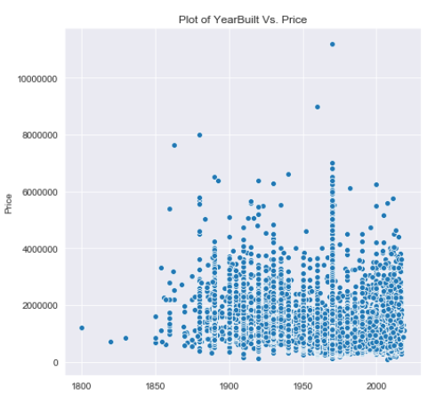
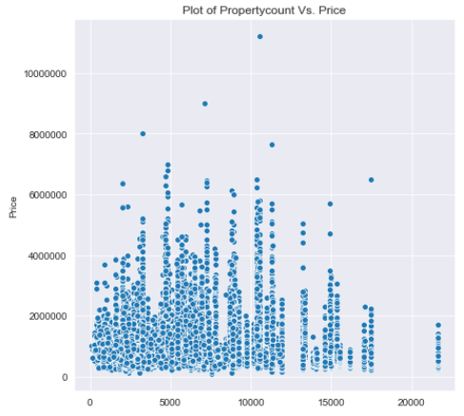
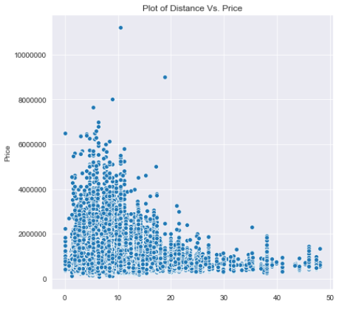
Exploring the data
The strongest relationship is seen between distance to the Central Business District and the price. This relationship implies that the further away from the CBD, the less valuable the house is.
The other two plots do not have nearly as strong of a relationship.
The year built vs. price shows a slight trend indicating that older homes have more value.

Slide 14
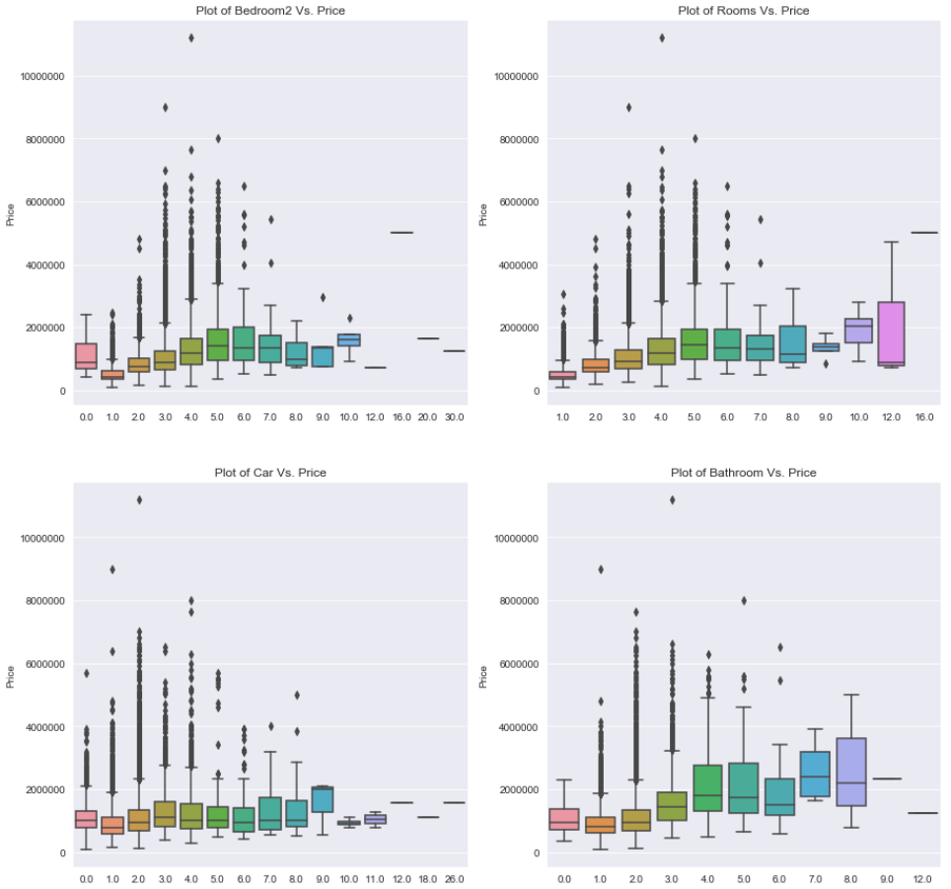
Exploring the Data
The top two plots are showing the room vs. price. They are showing the same data acquired from two different methods. The room vs plot on the right has less outliers and also no zero rooms.
There is an increasing trend for rooms and bathrooms indicating that more rooms and bathrooms will bring the value of the home up.
There is a weak positive relationship between the number of car spots and the home price.

Slide 15
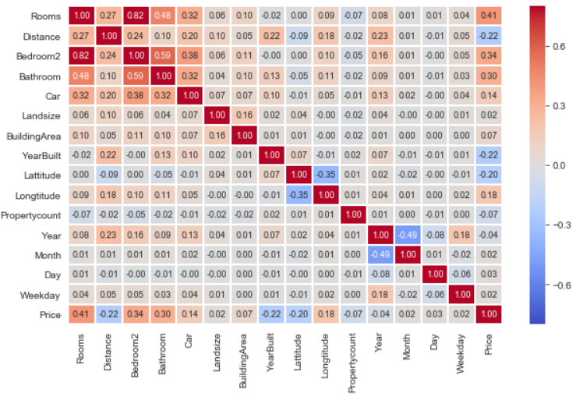
Exploring the data
The highest multicollinearity is between the two bedroom columns. The Bedroom2 variable was dropped.
Negative correlation with Price
Distance: the closer to the CBD the higher the price
Year Built: newer homes cost less than older homes
Latitude: further South decreases price
Positive correlation with Price
Rooms: more rooms means higher price
Bathroom: more bathrooms, higher price
Longitude: further East increases price
Car: more cars, higher price

Slide 16
Models
The regression models with be fit on a training set containing 70% of the data and tested on the remaining 30%.
The metrics that will be measures are the R-squared, Mean Square Error, Root Mean Square Error, and the Mean Absolute Error.
The R-squared explains how much of the dependent variable variance is covered with the model.
The MSE is the average squared difference between the estimated (predicted) values and what is estimated (actual).
The RMSE is the square root of the MSE, thus, the units for RMSE are the same as the dependent variable.
The MAE is the average absolute difference between the predicted and the actual value.
The MSE, RMSE, and MAE metrics are loss functions, so the goal is to minimize them.

Slide 17
Models built on imputed dataset
The following models were all built using the dataset that has the median housing price for each suburb imputed in for missing prices in each suburb.

Slide 18
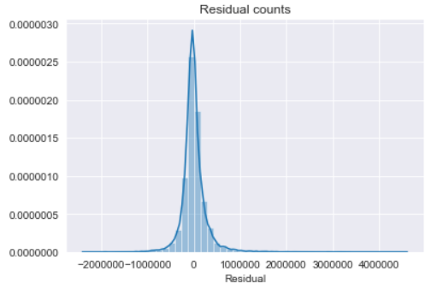
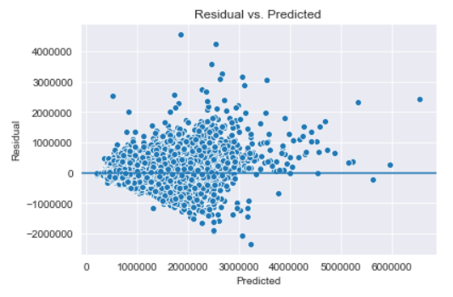
Models – Random Forest Regression
After a number of iterations fitting, cross validating and testing the Random Forest Regressor on the imputed dataset, the top 50 features were selected to build the final model.
The feature selection that was used was based on the feature importance method from Random Forest. When training a Random Forest Model, how much each feature decreases the weighted impurity in a tree can be computed. The feature importance ranks the features based on the average impurity decrease for each feature. For a regression tree the impurity is the variance.
Optimal features were obtained via a GridSearchCV:
{'max_depth': 11, 'max_features': None}
Training score: 0.7974697818516083
Cross Validation of training set:
[0.64343331 0.63760622 0.64067916 0.59773297 0.62308813]
Mean Square Error: 70831908729.67821
Root Mean Square Error: $266,142.65
Mean Absolute Error: 164334.52519
Test score: 0.6104587808729928

Slide 19
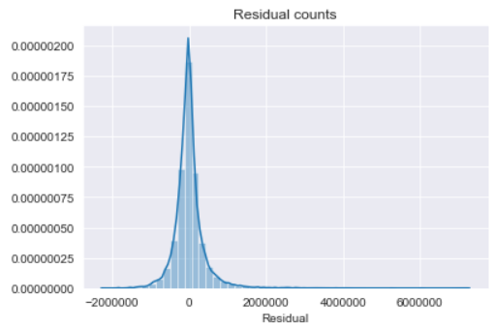
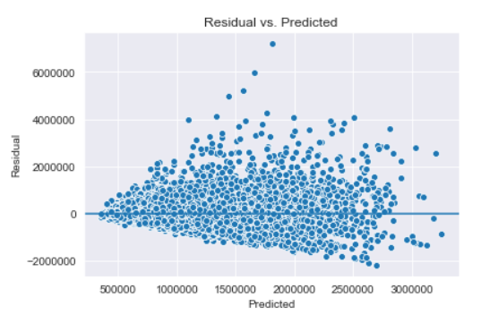
Models – K nearest neighbors regression
KNN regression was built with 10 nearest neighbors on the top 50 features selected from the Random Forest feature selection.
Training Score: 0.5259094079416088
Mean Square Error: 165806079968.14990
Root Mean Square Error: $407,192.93
Mean Absolute Error: 250074.43323
Cross Validation for Training Set:
[0.40994419 0.42468889 0.43896182 0.38301778 0.36841403]
Test Score: 0.4127370446070734

Slide 20
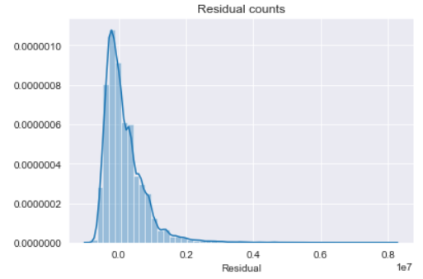
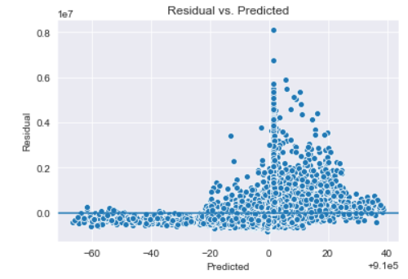
Models – Support Vector Regression
The kernel for the SVR was set to Radial Basis Function
Training Score: -0.06668488943428774
Mean Square Error: 373057055003.89978
Root Mean Square Error: $610,783.97
Mean Absolute Error: 407035.38581
Cross Validation for Training Set:
[-0.07838865 -0.05879618 -0.06416778 -0.0578118 -0.07238569]
No testing was done due to really poor fitting and time constraints.

Slide 21
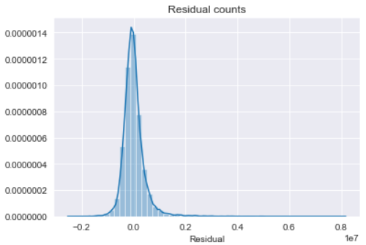
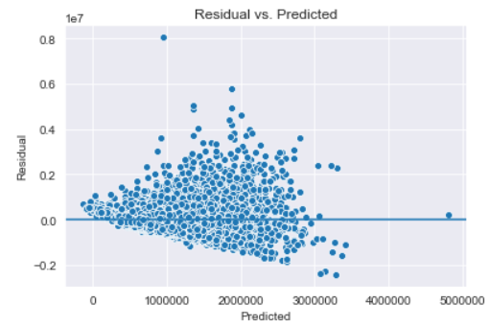
Model – linear regression
The linear regression started with the top 50 features from the Random Forest feature selection and further feature selection was done to get the model down to 15 features.
The feature selection for the linear regression utilized the statsmodels package. From statsmodels, the t-statistic and p-value for each feature were attained and a ‘backwards pass’ wrapper method was applied to further trim down the feature set.
Training score on full 50: 0.5739654857989658
Training Score: 0.4946980097412227
Mean Square Error: 176721798762.44653
Root Mean Square Error: $420,382.92
Mean Absolute Error: 278074.11665
Cross Validation Score for Training Set:
[0.50103775 0.5106907 0.51807667 0.4725626 0.46606148]
Test Score: 0.4664631870944139

Slide 22
Model – linear regression
Price change per unit increase
Lattitude -$444,217.88
Regionname_Northern Metropolitan -$264,016.14
Regionname_Western Metropolitan -$261,934.53
CouncilArea_Wyndham City Council -$244,041.04
CouncilArea_Brimbank City Council -$166,184.82
Distance -$28,763.43
YearBuilt -$2,679.62
Bathroom $74,526.97
CouncilArea_Bayside City Council $233,815.66
Rooms $258,708.50
SellerG_Marshall $295,807.13
Postcode_3186.0 $376,793.48
Postcode_3206.0 $431,217.87
Postcode_3103.0 $448,069.53
Suburb_Canterbury $803,192.54
Intercept: -10960156.33369576
These are the top 15 features from the linear regression model. Although, the linear regression did not perform as well as the Random Forest, it is nice to be able to see the how each feature from the model influences the housing price. For each unit increase in the feature, the price changes accordingly. For the categorical features that remained in the final model, the impact the price whether or not the home is in that particular area.

Slide 23
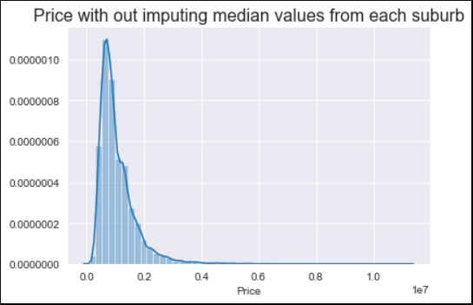
Models built on Dropped dataset
The following models were all built using the dataset that has the missing values from the price variable dropped.
The distribution is still normal with right skewness.

Slide 24
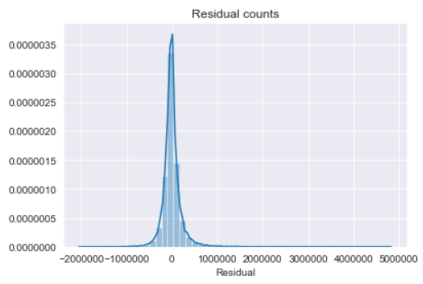
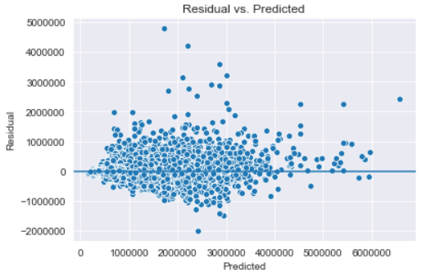
Models – Final random forest regression
Through a similar process of selecting the top features using the feature importance, the final model was able to be built using the top 10 features.
GridSearchCV optimized the parameters: max_features=‘sqrt’ and max_depth=15
Training Score: 0.8821914378748874
Mean Square Error: 48508951918.41641
Root Mean Square Error: $220,247.48
Mean Absolute Error: 129902.24347
Cross Validation on Training Set:
[0.72560679 0.75357455 0.73506083 0.73868509 0.73870189]
Test Score: 0.7432904911014883

Slide 25
Model – final random forest regression
Feature Importance
Regionname_Southern Metropolitan 0.315162
Rooms 0.238124
Distance 0.193718
Type_u 0.082151
Landsize 0.040412
BuildingArea 0.039214
Regionname_Eastern Metropolitan 0.036852
Longtitude 0.027190
Lattitude 0.016569
Bathroom 0.010608
From the final Random Forest model, these are the most important features. The Random Forest, unfortunately, does not describe how these features impact the price as directly as the linear model.
This is the downfall for the Random Forest.

Slide 26
Models – linear regression
The linear regression on the drop_df dataset did not test well. The following results are based on the full drop_df dataset.
Training Score: 0.6981660872854034
Mean Square Error: 124283383950.22974
Root Mean Square Error: $352,538.49
Mean Absolute Error: 221736.71109
Cross Validation for Training Set:
[0.64342529 0.67207825 0.6875702 0.66489996 0.68720154]
Test Score: 0.20687032794151192

Slide 27
Conclusion
The model with the highest predictive capability for the housing prices is the Random Forest Regressor built on the dataset that dropped the missing values from the price value.
This model could be used by a real estate agent in the Melbourne, Australia area to predict housing prices. The model trained on training set that contains 70% of the data and fits the test data with an R-Squared score of 74.3%. This is how much of the dependent variable variance is explained.
The most important features can be determined from this model, which is beneficial but when comparing the explanatory value of the linear model to this model it fails. The linear model, albeit testing worse, does give a more clear description of how the features explain the housing pricing.

